Slide 1
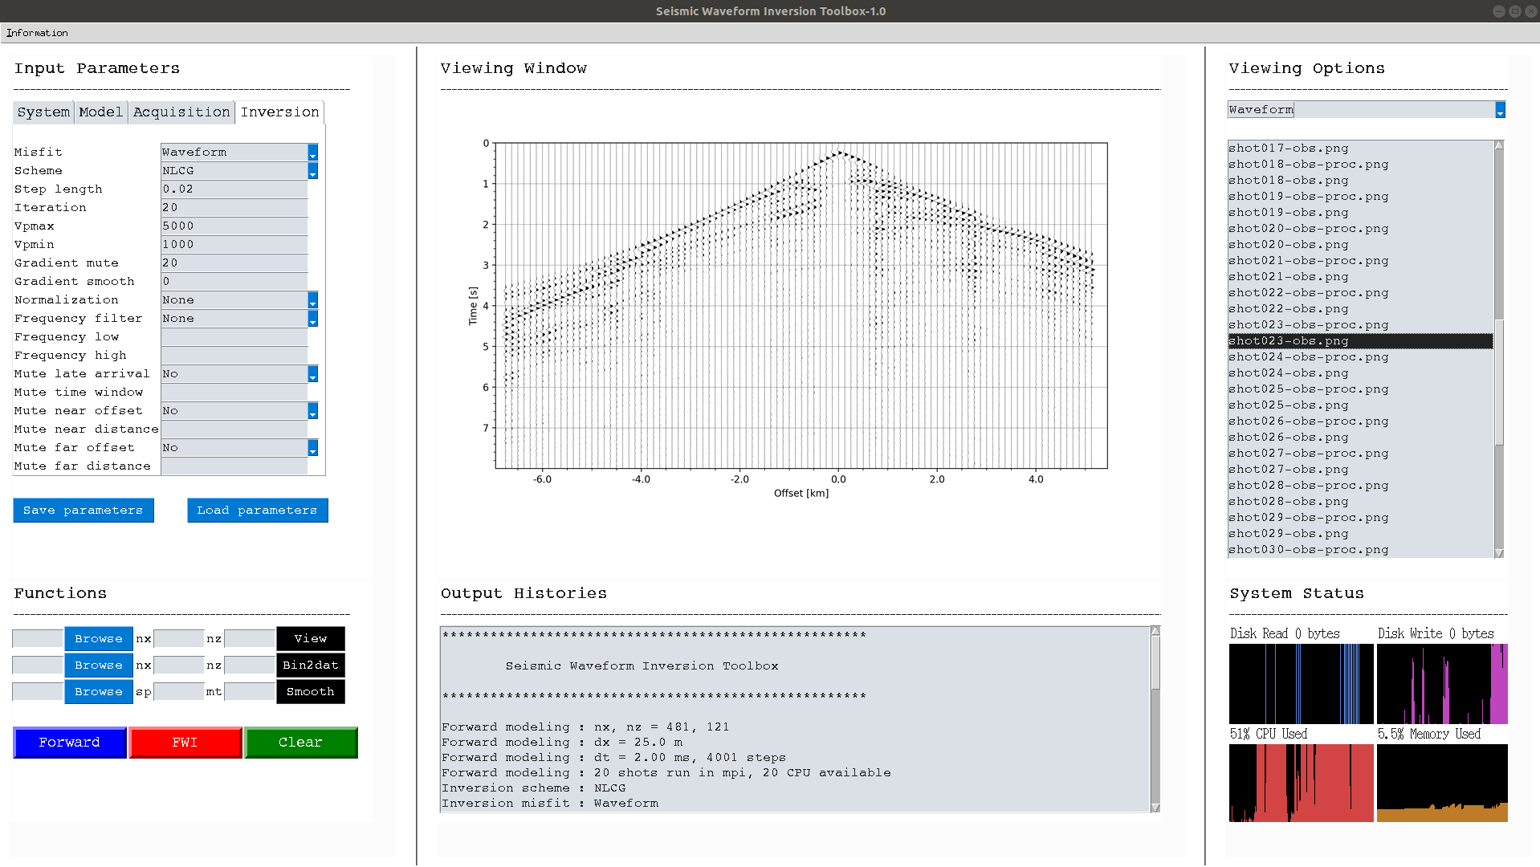
1. Input Parameters
2. Viewing Window
3. Viewing Options
3. Functions
4. Output Histories
6. System Status

Slide 2
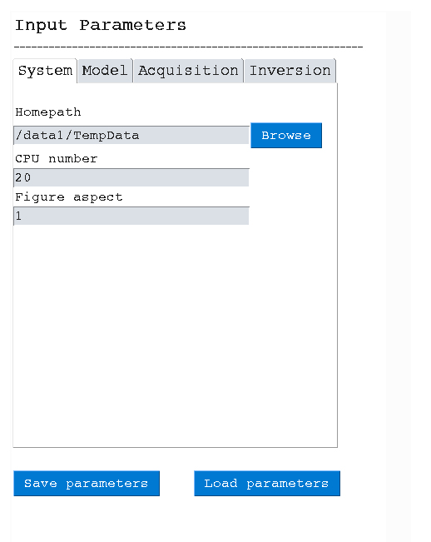
the working folder
CPU number
figure aspect for plotting
save all parameters
load previously saved parameter file

Slide 3
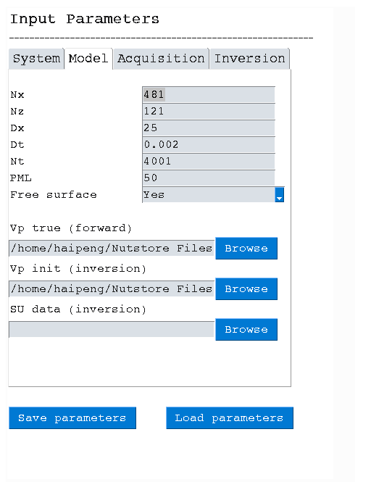
model size along x direction
model size along z direction
finite-difference size (in meter)
finite-difference temporal interval (in second)
finite-difference time step
PML size, use a relatively large one, i.e., 50
free surface or not
true Vp model saved in the txt file
initial Vp model saved in the txt file
field data folder, named as:
src1_sg.su, src2_sg.su, ..., src40_sg.su, ...
For synthetic model FWI: set Vp true & Vp init
For field data application: set Vp init & SU data

Slide 4
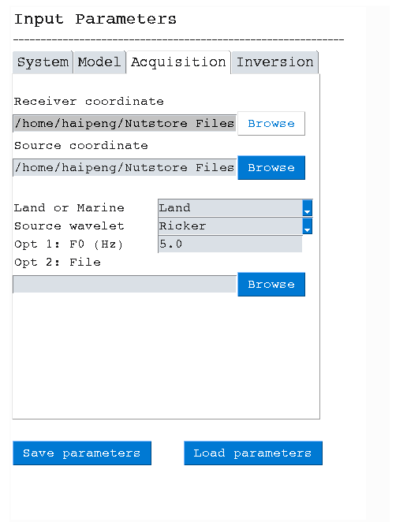
receiver file, see examples for detailed format
source file, see examples for detailed format
land or marine acqusition
set source wavelet: Ricker or from file
if Ricker, set the dominant frequency
if from file, set the file path

Slide 5
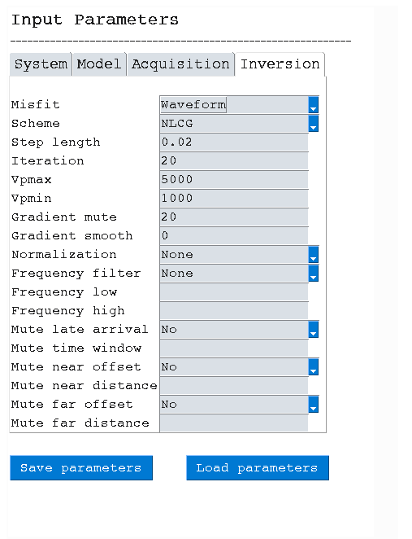
misfit function type
optimization scheme: NLCG or L-BFGS
step length, i..e, 0.01 or 0.02
No. of iteration
maximum Vp
gradient mute size. For marine case, it’s the water layer size; for land case, set as 5 or 10.
minmum Vp
gradient smoothing size, i..e, 5, 10, 20
in Hz
in Hz
time window (in second ) after the first break, i.e., 1.0
near offset distance (in meter )
far offset distance (in meter)

Slide 6
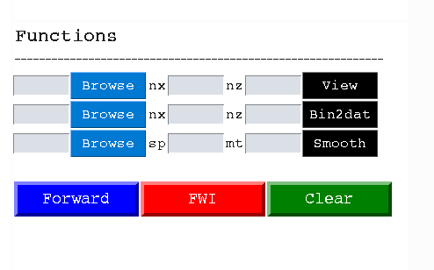
view a txt file (no nx & nz) or binary file (require nx & nz)
convert a binary file to txt file (require nx & nz)
smooth a model stored in the txt filea. sp means the smooth radius, and mt means the top mute for water layer.
Forward: run forward modeling to generate the synthetic dataset;
FWI: run full-waveform inversion. The initial model and the data should be both prepared;
Clear: clear the output histories.

